Slide 1
Seven Deadly Mistakes of PowerPoint Slides
And how you can fix them
EAC 594

Slide 2
Agenda
Review: Importance of Visuals
Common mistakes in slide presentations
How to avoid them
Creating effective slide presentation

Slide 3
Visual Aids
The goal is to help your audience
retain, understand and enjoy your presentation.
https://blog.bannersnack.com/online-marketing-strategies/

Slide 4
Mistake 1: Images and Text

Slide 5
Mistake 1: Images and Text
Solution:
Keep the text and image separate
Consolidate the text in one part of the image
https://s.abcnews.com/images/Business/ev-cars-03-jag-i-pace-ht-jc-210217_1613596168201_hpMain_16x9_992.jpg

Slide 6
Mistake 2: The Endless “Summary”

Slide 7
Mistake 2: The Endless “Summary”
Solution:
Avoid too much text
Use bullet points
Write key words and main points
Font type needs to be large enough to be read (font size between 28 and 18 point)

Slide 8
Mistake 3: 100 Graphs on one slide

Slide 9
Mistake 3: 100 Graphs on one slide
Solution:
Display one chart/graph/image per slide

Slide 10
Mistake 4: Death by Bullet Points

Slide 11
Mistake 4: Death by Bullet Points
Solution:
Focus on main ideas
Rule of 6 (six bullet points; six words each)
Avoid overkill
Notes:
Hyperlinks require a descriptive title
Any pictures or graphs within a document must be given alternative text.

Slide 12
Mistake 4: Death by Bullet Points
Solution example

Slide 13
Mistake 5: Rainbow Presentation

Slide 14
Mistake 5: Rainbow Presentation
Solution:
Follow the AODA accessible document guidelines and standards
Light background, dark fonts and vice verse
Avoid too many font styles and sizes
Avoid too many colours
Avoid fluorescent colours

Slide 15
Mistake 6: Boring Minimalist

Slide 16
Mistake 6: Boring Minimalist
Solution:
Remember the power of visual communication - understandable, memorable, and engaging
Use colours, animations or graphics.
Use a template or theme that complements your topic
Keep it simple, but elegant!

Slide 17
Mistake 6: Boring Minimalist
Solution example

Slide 18
Mistake 7: Pictures and Fonts

Slide 19
Mistake 7: Pictures and Fonts
Solution:
Choose your images wisely
Use royalty-free, high-definition images
Avoid over-stylized fonts and clipart
Hyperlinks require a descriptive title
Any pictures or graphs within a document must be given alternative text.

Slide 20
Creating Slide Presentations
– Best Practices

Slide 21
Two Types
Structured
Free form
https://eslide.com/business-presentation-design/

Slide 22

Structured Slides
Are template-based, so every slide has the exact same look.

Slide 23
Structured Slides
Example

Slide 24
Structured Slides
Example

Slide 25
Structured Slides
When to use:
Routine and straight forward business presentations
Examples: product news, project updates and sales summaries

Slide 26
Structured Slides
Pros
Cons
Quick and easy to create (pick your template and start typing)
Can be more effective for communicating complex content
Too many slides of dense, highly structured bullet points can cause audience to disengage
Reading off the slides

Slide 27
Free Form Slides

Slide 28
Free Form Slides
Pros
Cons
Can overcome problems of text-heavy structured slides
Can provide a more dynamic, engaging audience experience
Creatively demanding and time-consuming to produce
May put more stress on speaker
Require care with information architecture

Slide 29
Slide Design Examples

Slide 30

Unedited

Slide 31

Revised

Slide 32
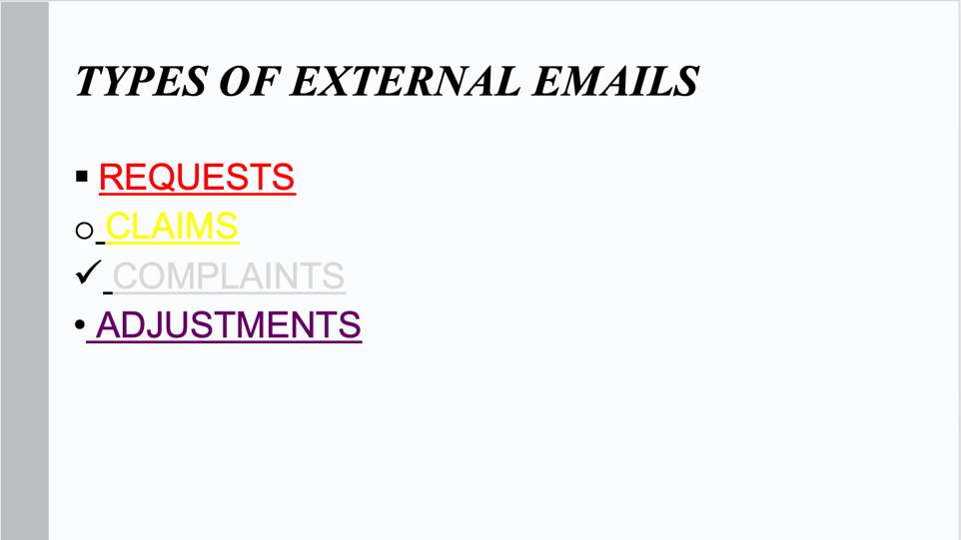
Unedited

Slide 33
Types of External Emails
Requests
Claims
Complaints
Adjustments
Revised

Slide 34
Types of External Emails
Requests
Claims
Complaints
Adjustments
Revised

Slide 35
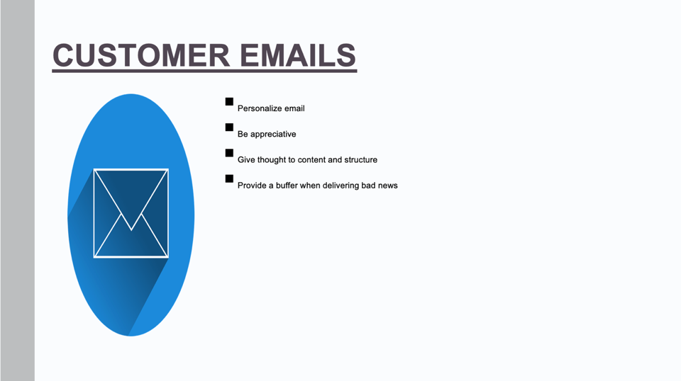
Unedited
Right click on the image
Lock the aspect ratio before resizing

Slide 36
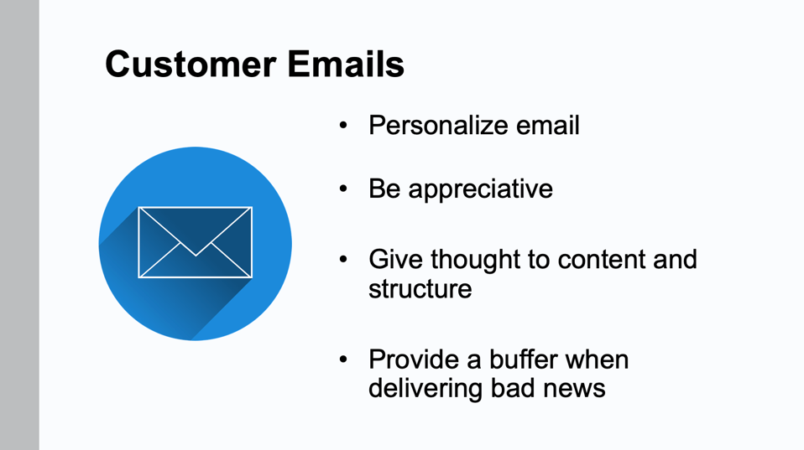
Revised

Slide 37
“Before” – Ineffective PowerPoint Slide
Reasons for Selling Online
Your online business can grow globally.
Customer convenience
You can conduct your business 24/7
No need for renting a retail store or hiring employees.
Reduce inquiries by providing policies and a privacy statement.
Customers can buy quickly and easily.
Slide contains bullet points that are not parallel
Overlap in meaning 2nd and 6th bullet points are same

Slide 38
“After” – Improved PowerPoint Slide
Why You Should Sell Online
Grow business globally.
Offer convenience to customers.
Conduct your business 24/7
Save on rent and staff.
Create policies to reduce inquiries.
More convincing title illustrating the “you” view
Shorter bullet points – parallel (action) verbs create emphasis
Photo adds interest

Slide 39
Source
Top 10 world's worst PowerPoint presentations
https://www.pcworld.idg.com.au/slideshow/366369/world-worst-powerpoint-presentations/
Bad PowerPoint Examples You Should Avoid at All Costs
https://24slides.com/presentbetter/bad-powerpoint-examples-you-should-avoid/

